Slide 1

Professional Development for Federal Buildings Personnel
Program Brief – April 28, 2015

Slide 2
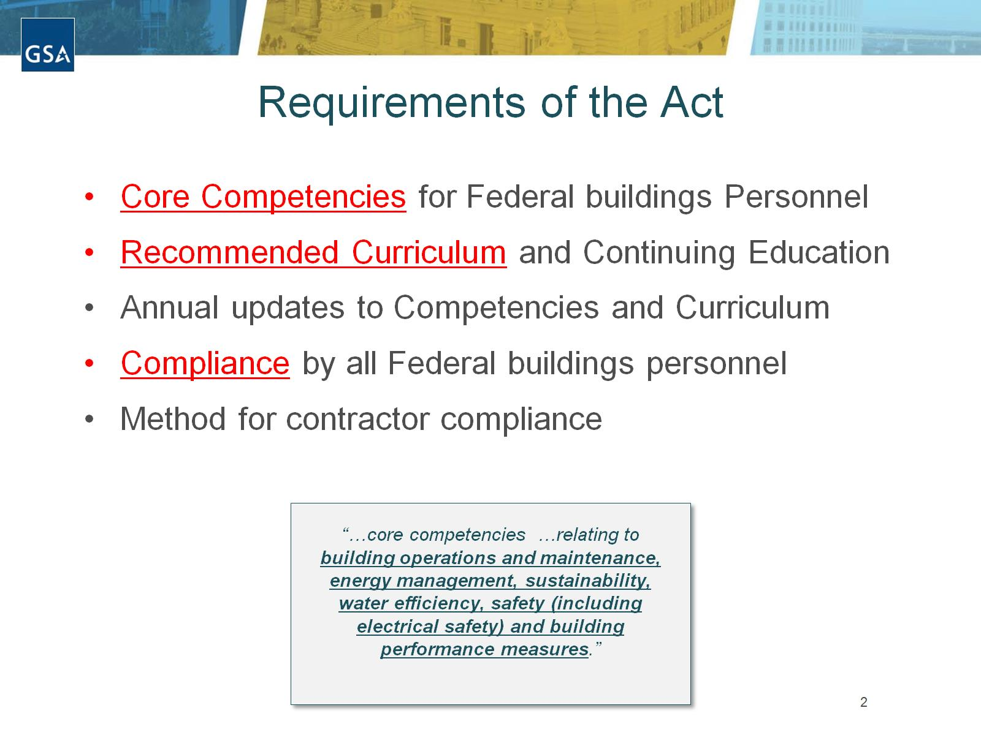
Requirements of the Act

Slide 3
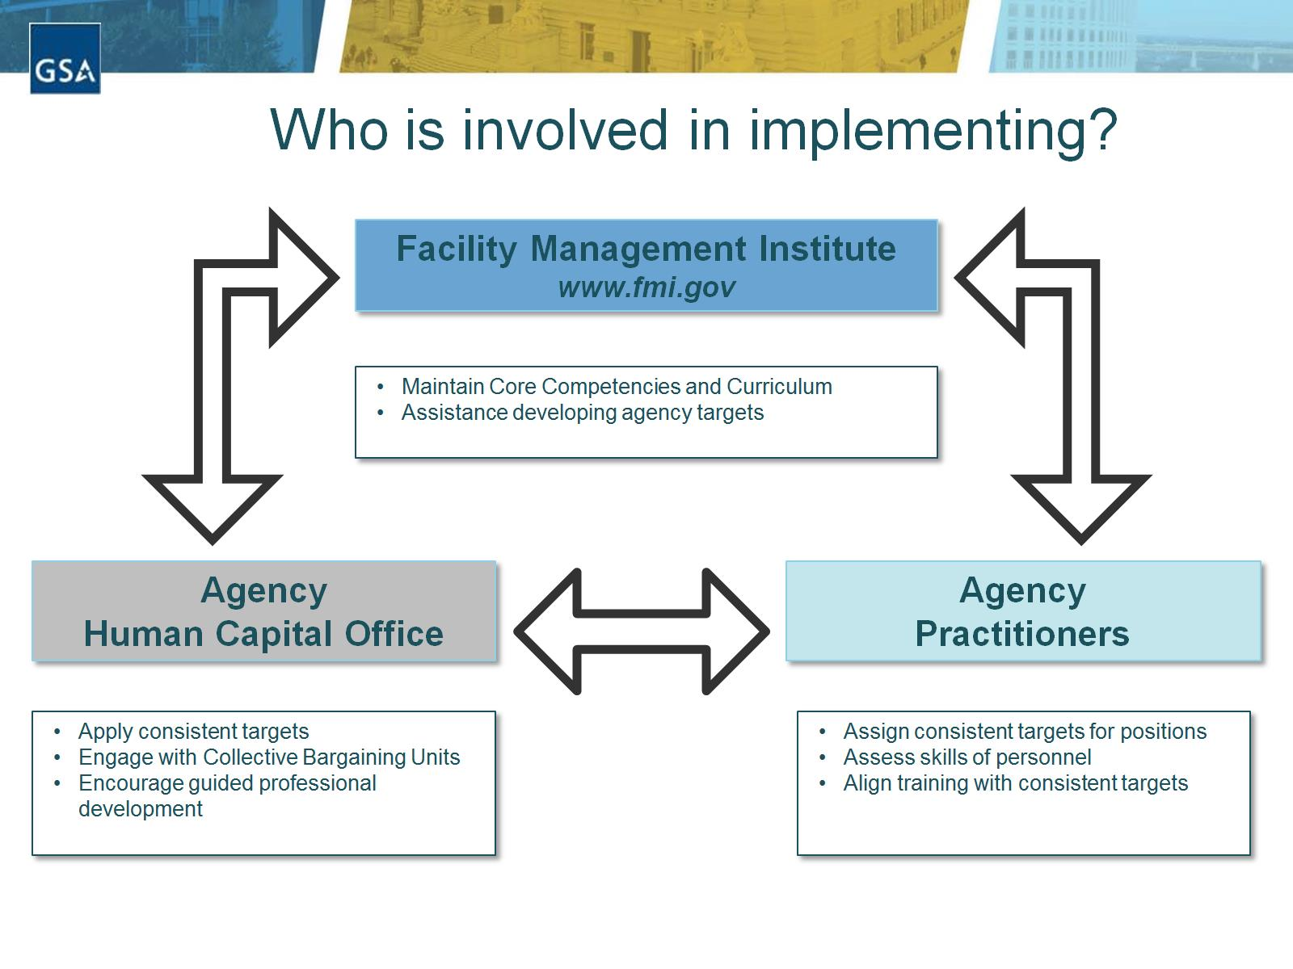
Who is involved in implementing?

Slide 4
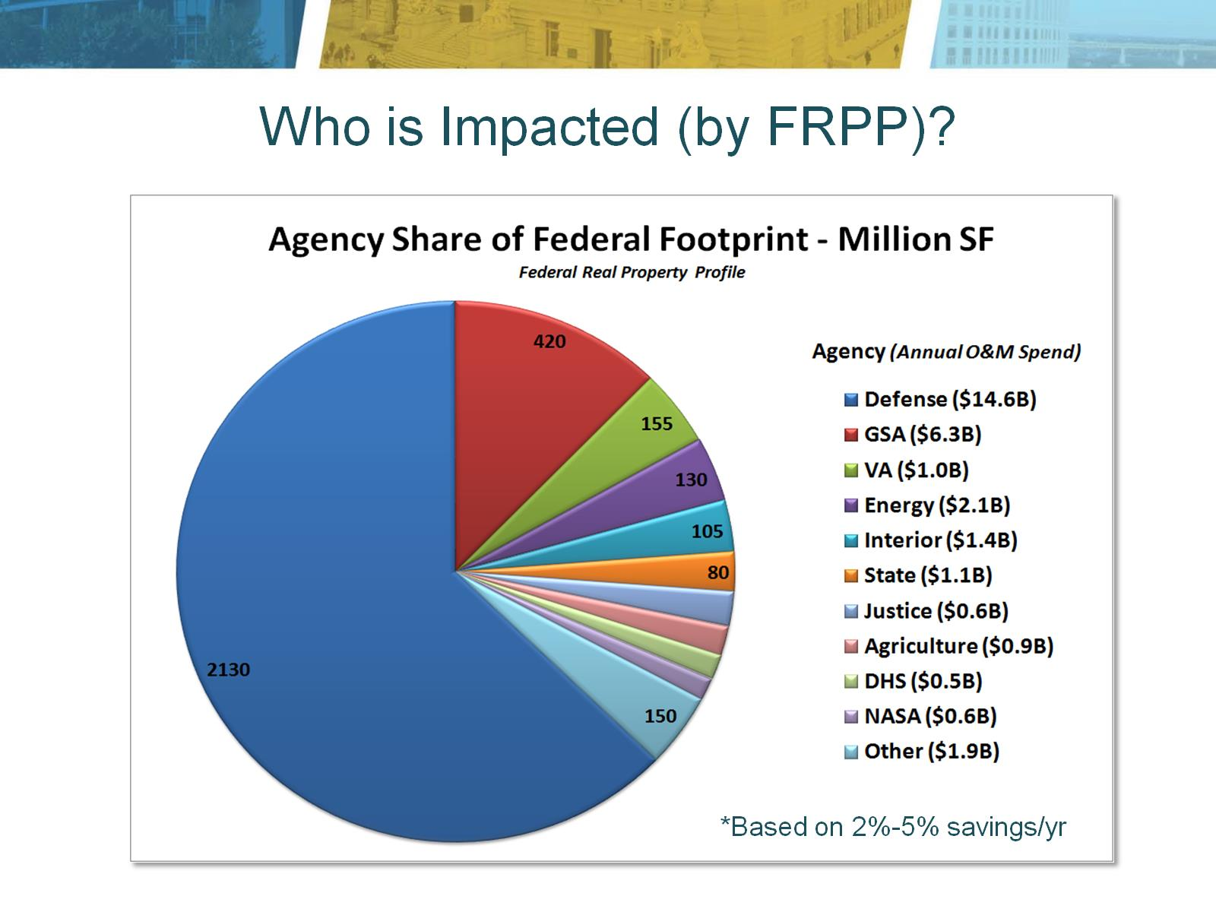
Who is Impacted (by FRPP)?

Slide 5

Why? It Saves Money

Slide 6
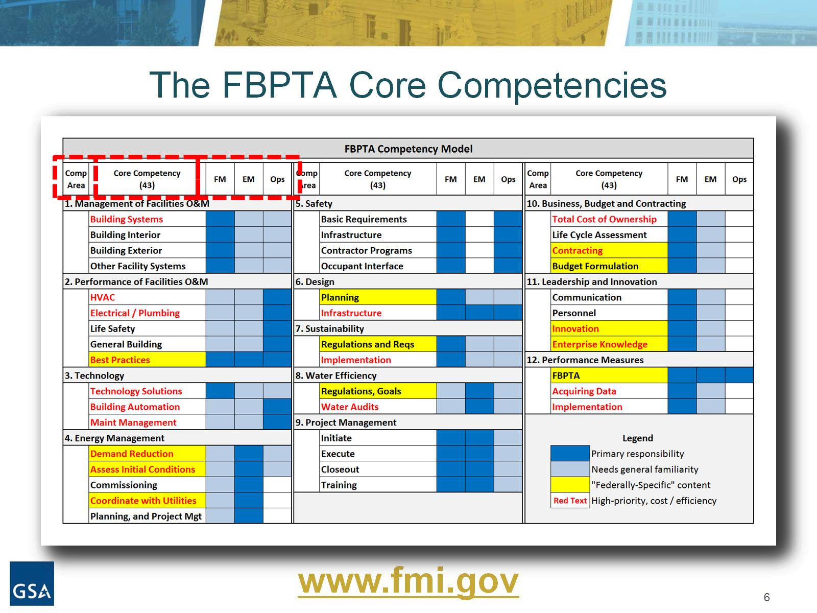
The FBPTA Core Competencies

Slide 7
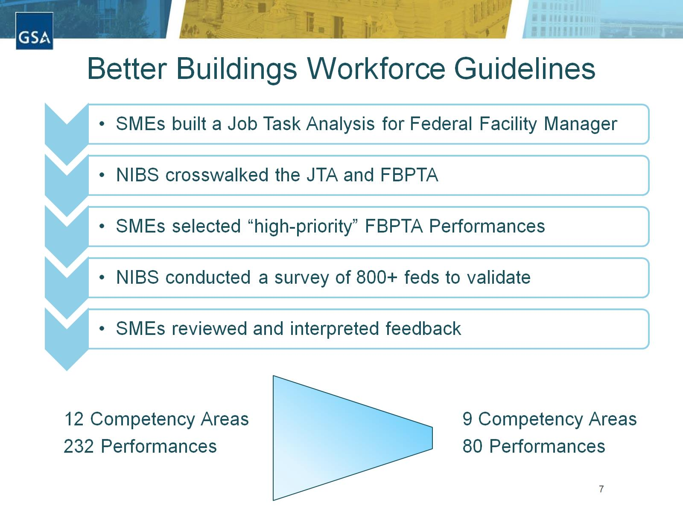
Better Buildings Workforce Guidelines

Slide 8
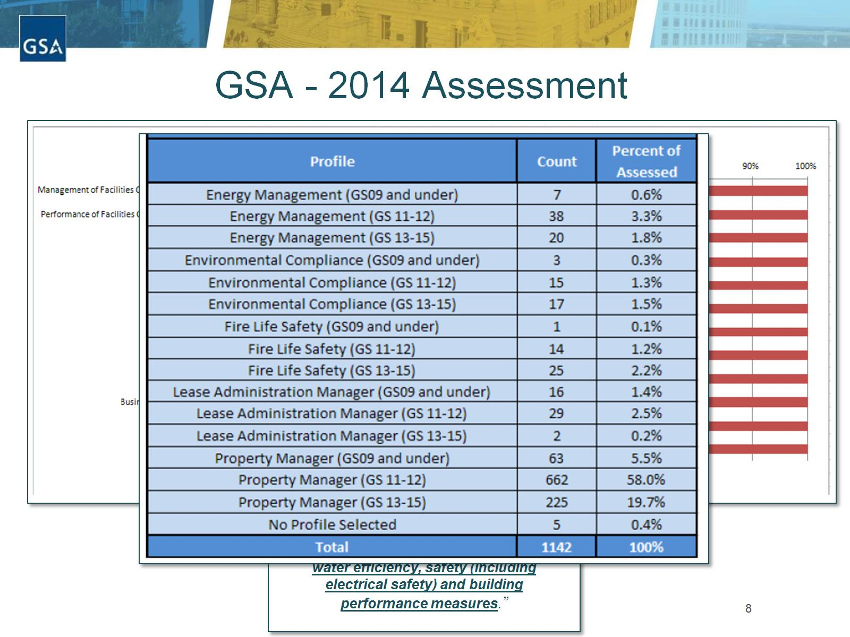
GSA - 2014 Assessment

Slide 9
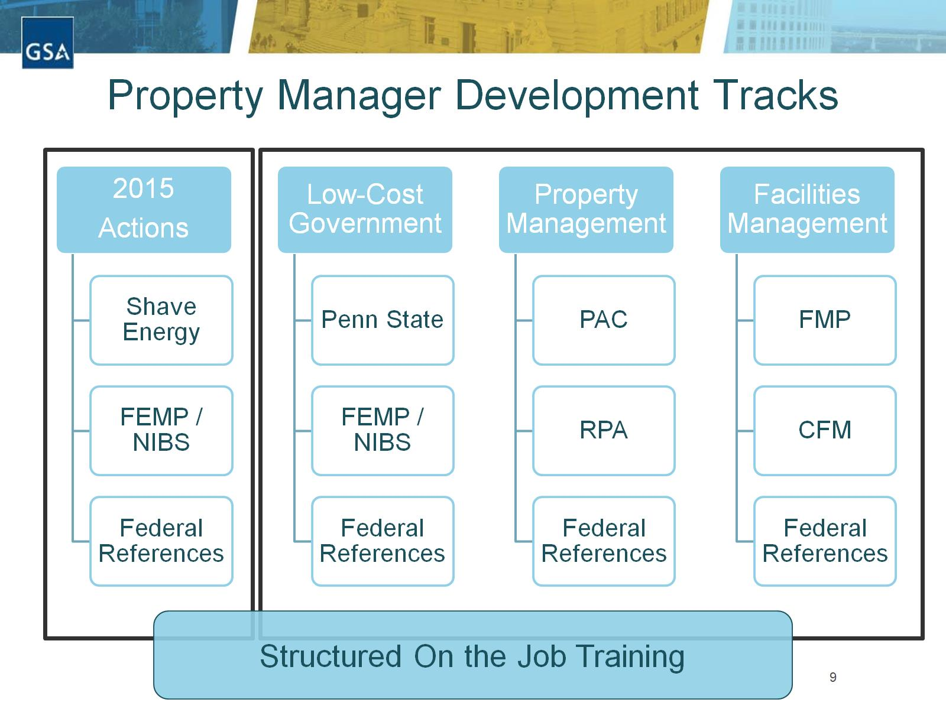
Property Manager Development Tracks

Slide 10
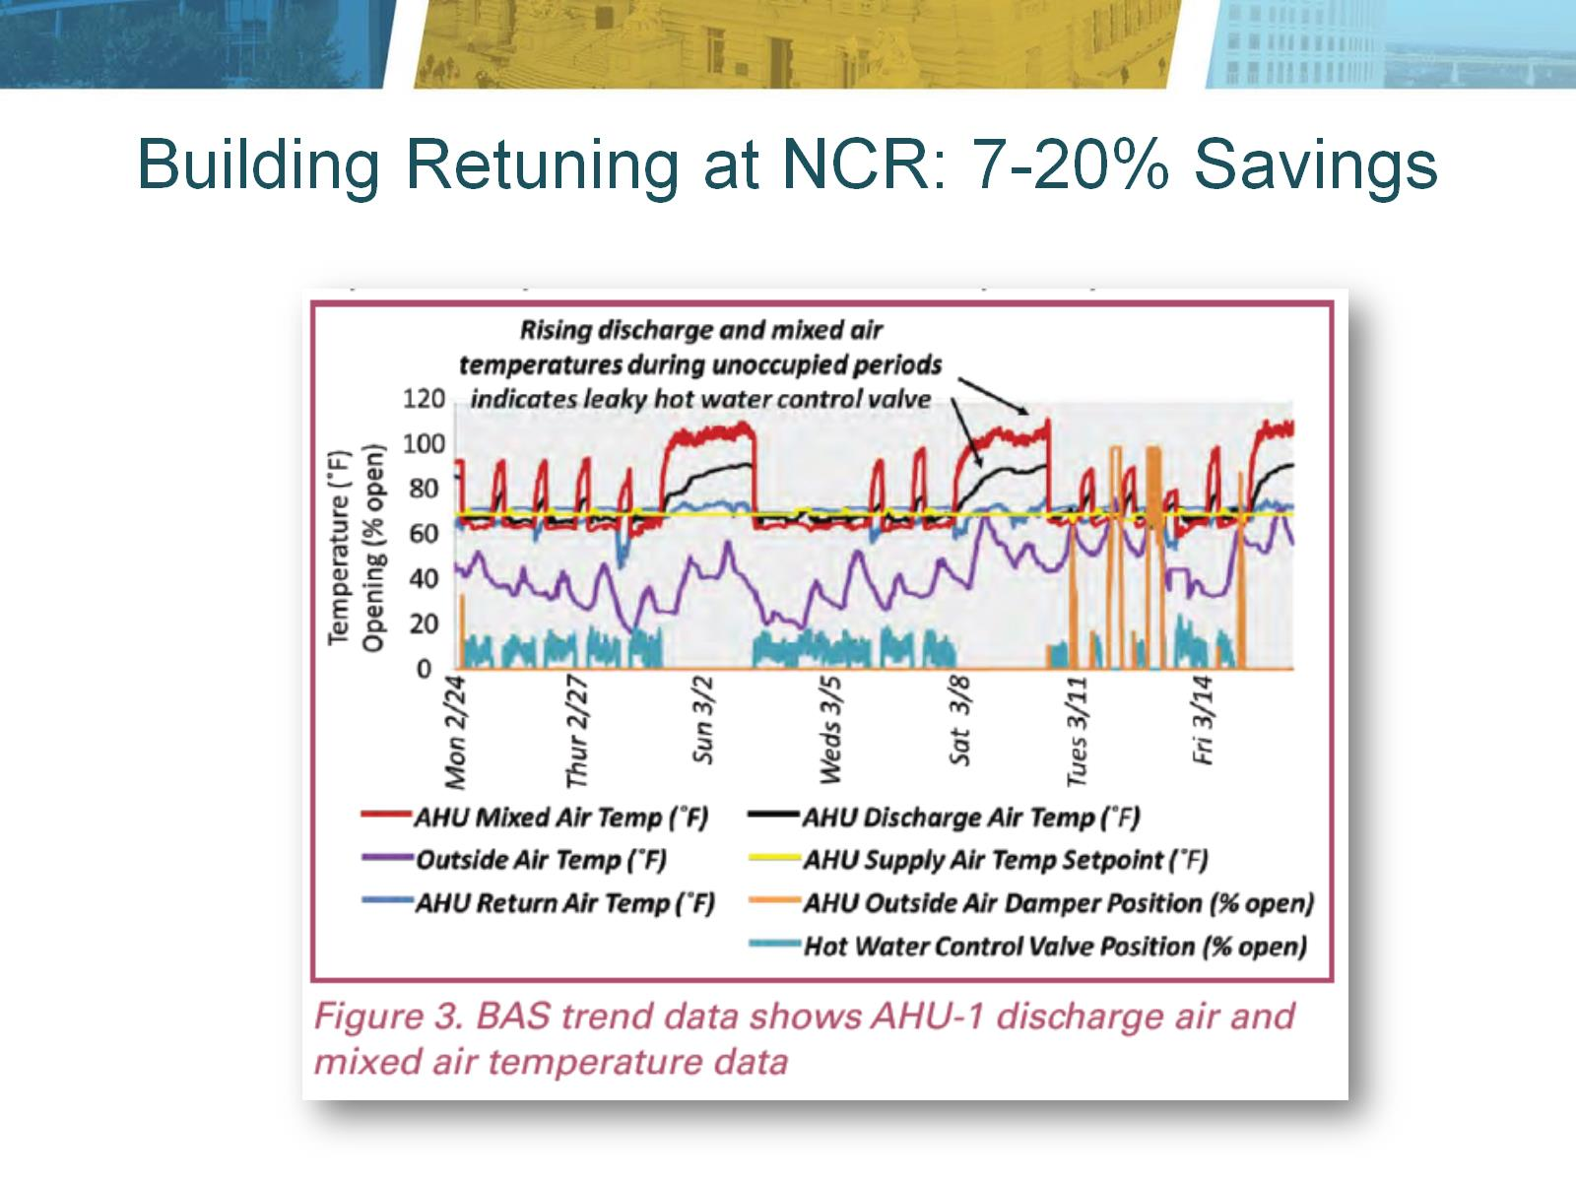
Building Retuning at NCR: 7-20% Savings

Slide 11
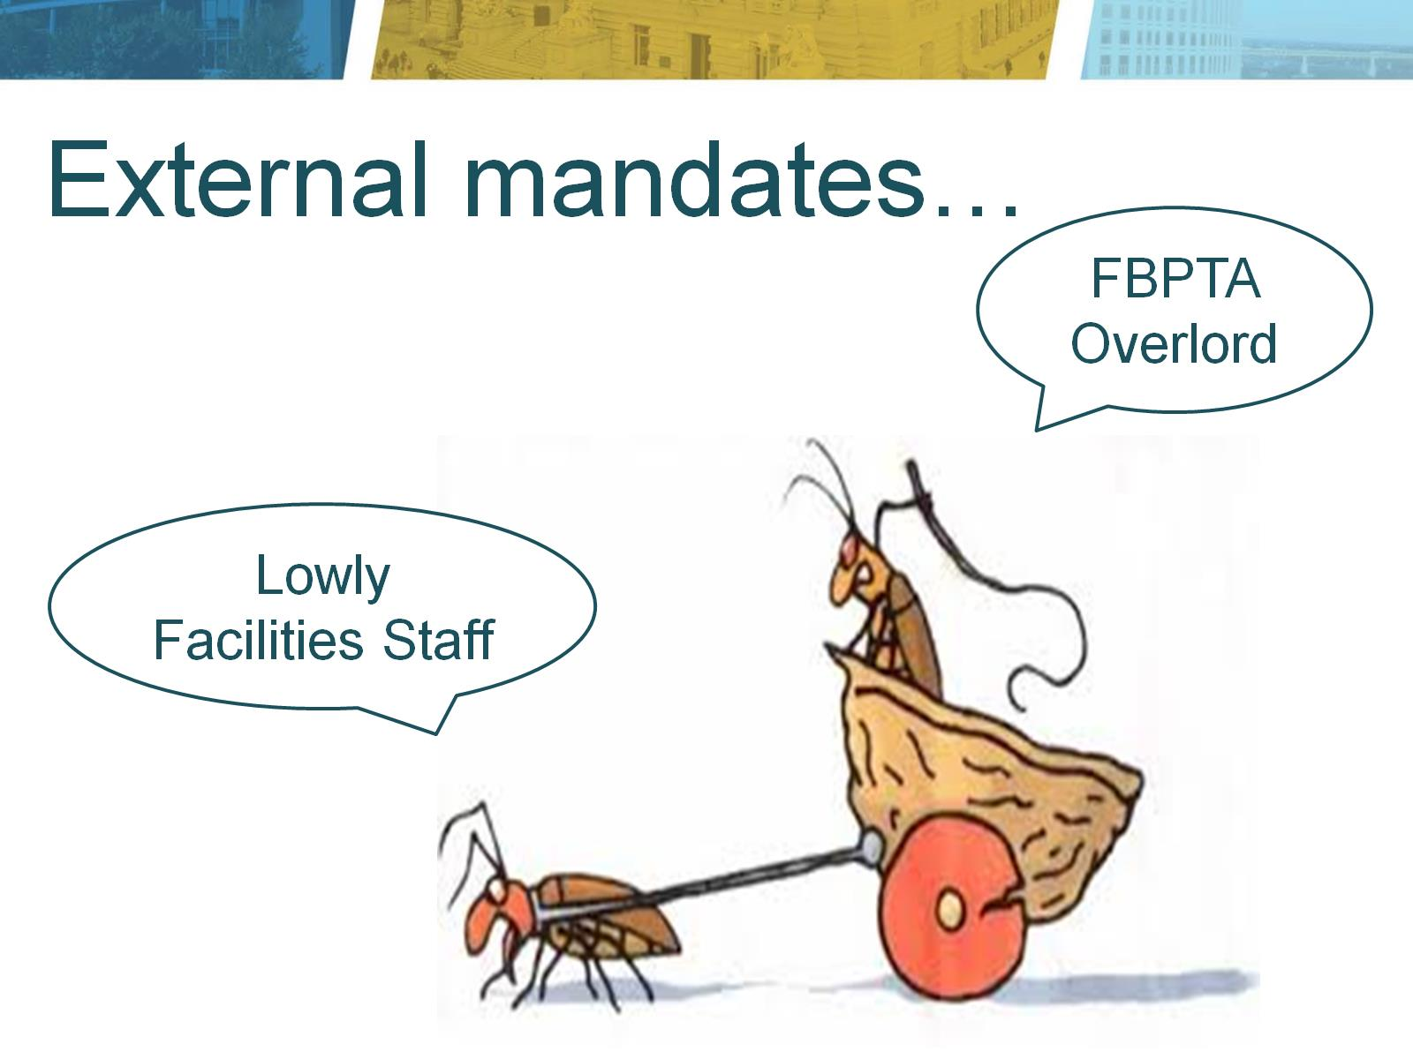

Slide 12


Slide 13
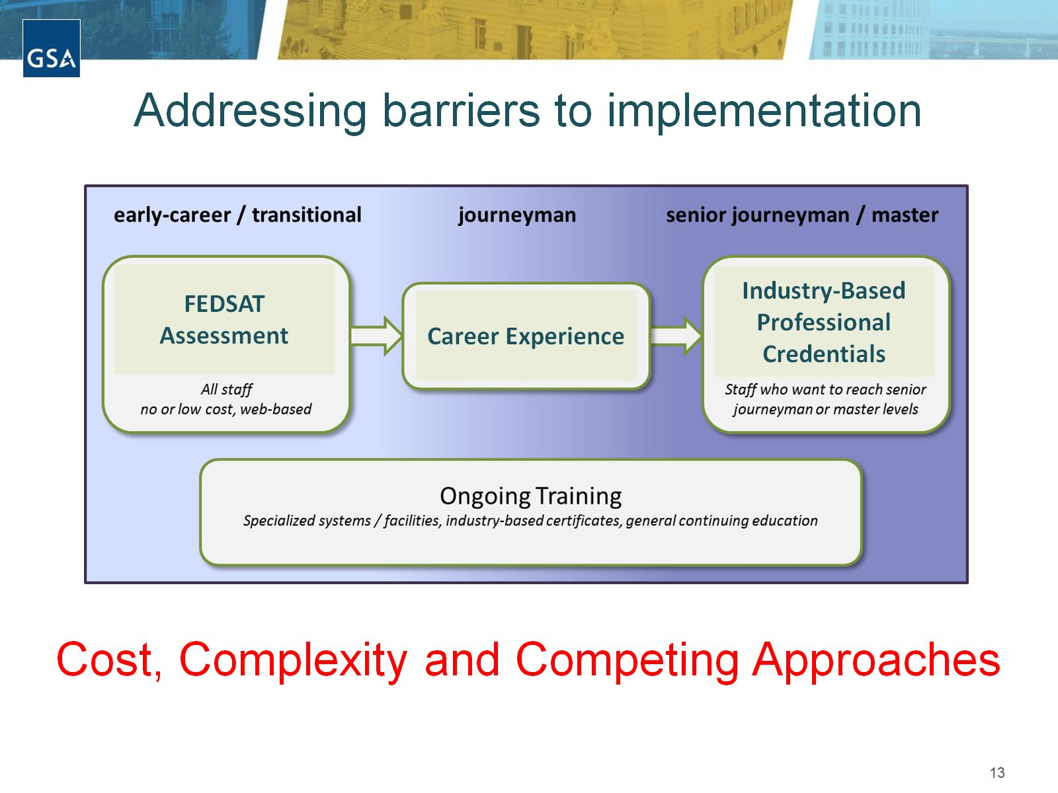
Addressing barriers to implementation

Slide 14
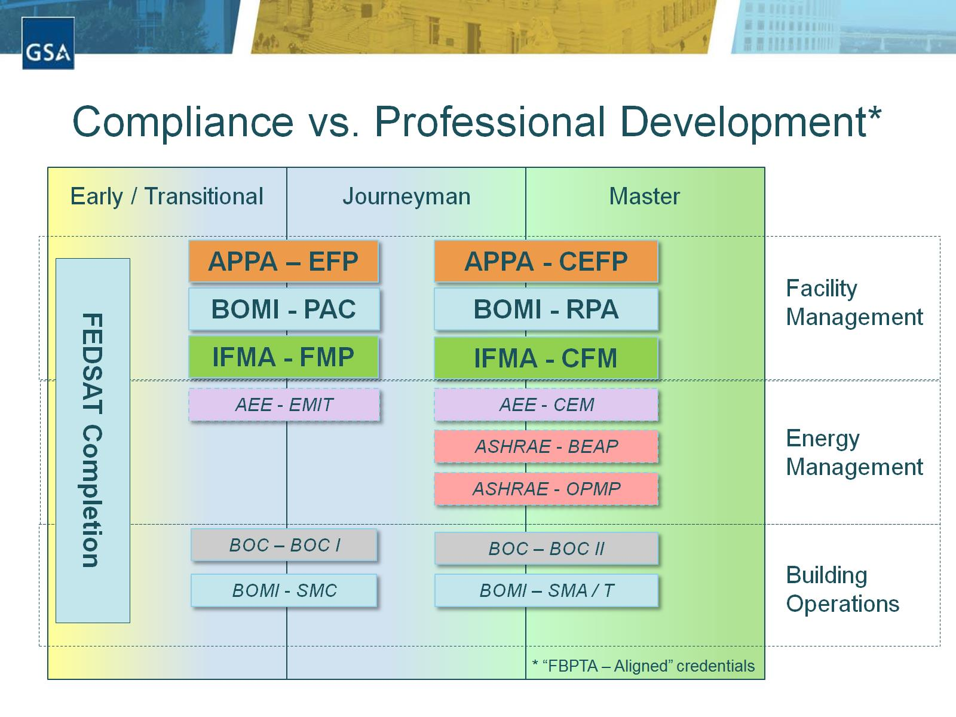

Slide 15

FEDSAT Assessment on SF Tool

Slide 16
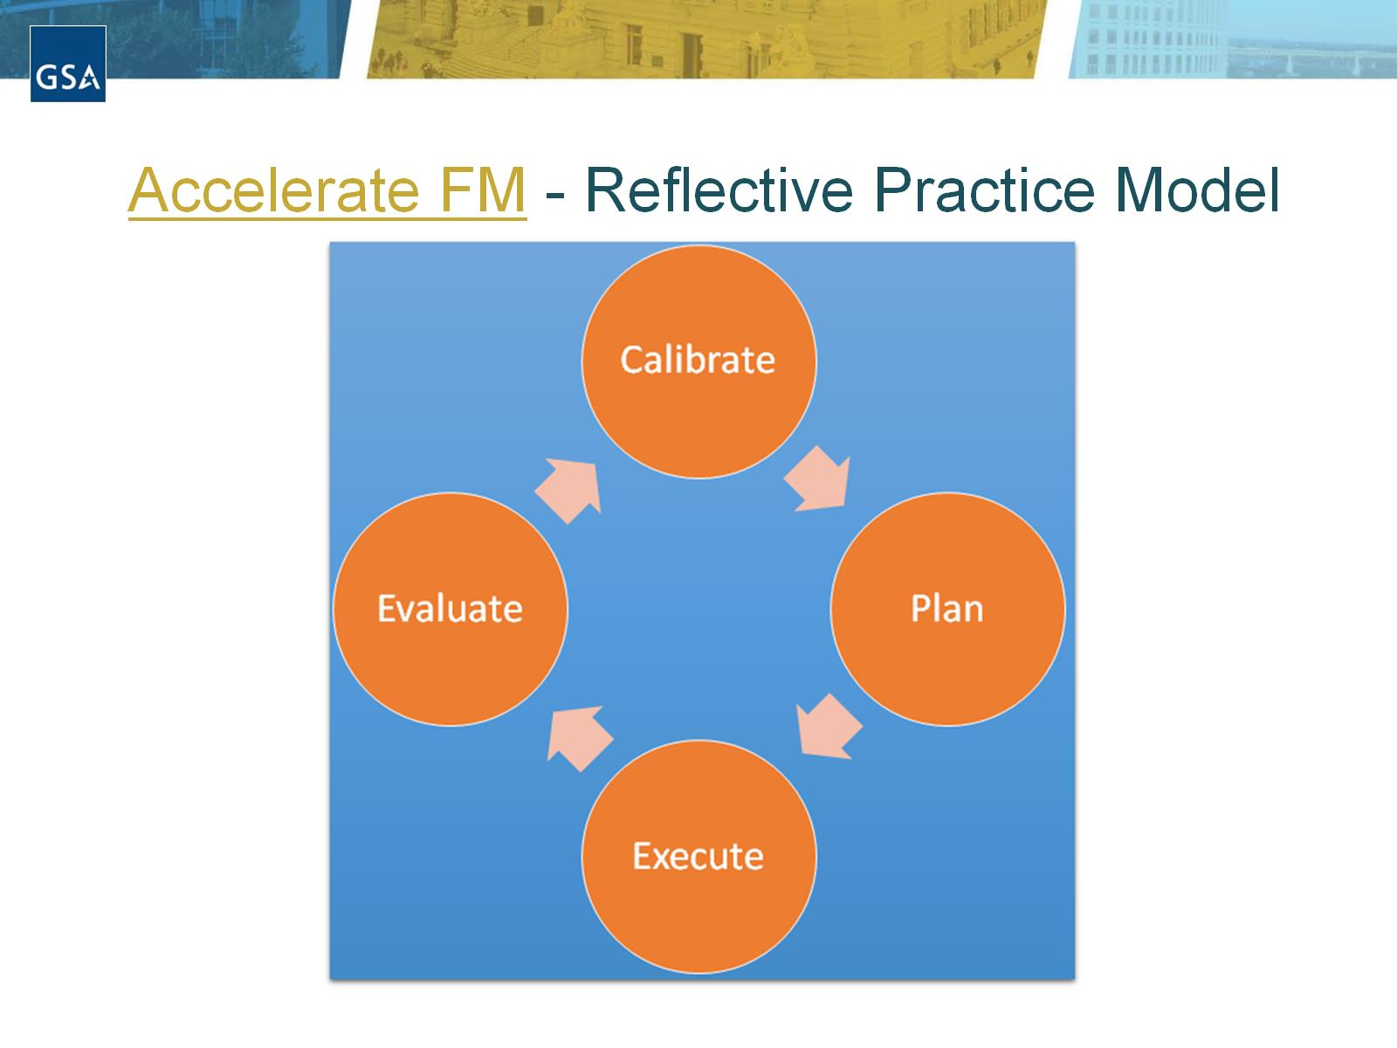

Slide 17
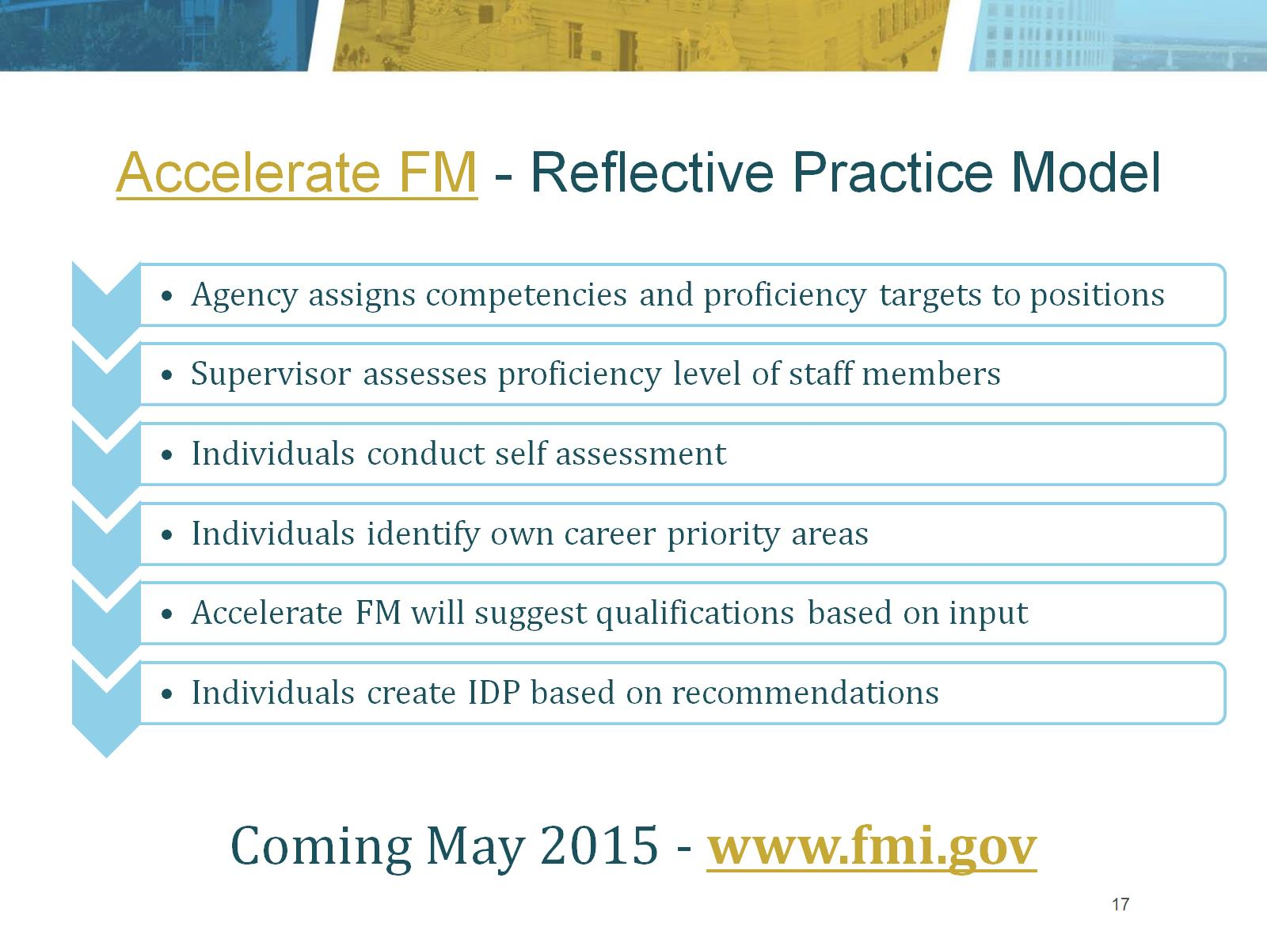

Slide 18
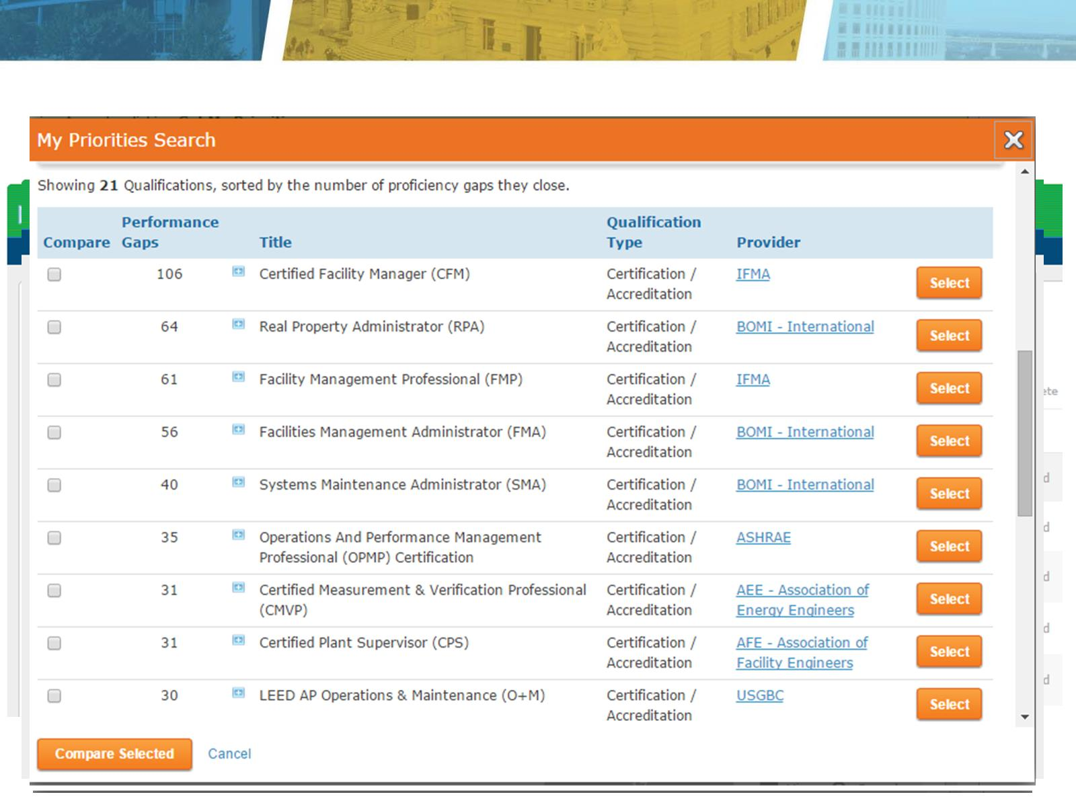

Slide 19
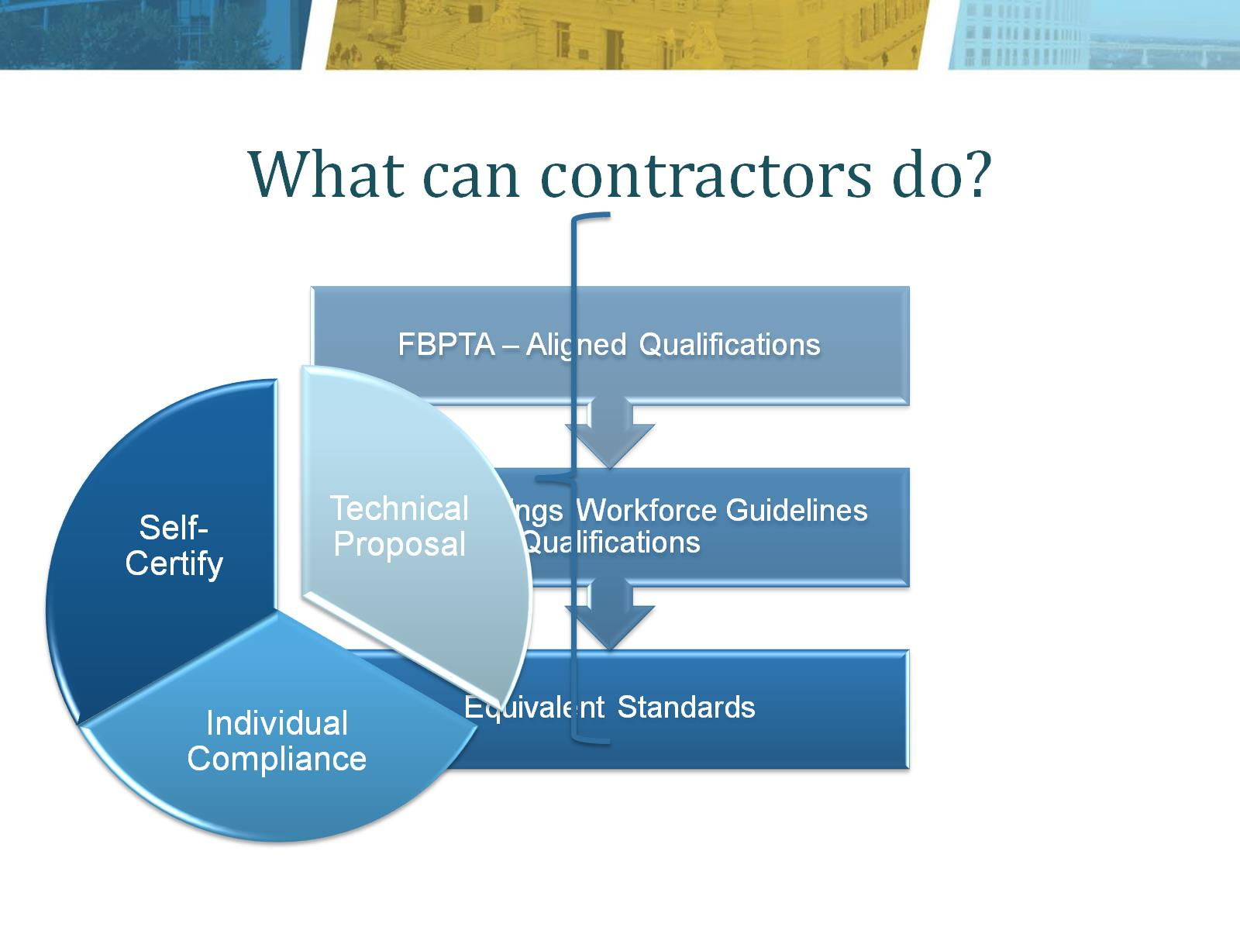

Slide 20
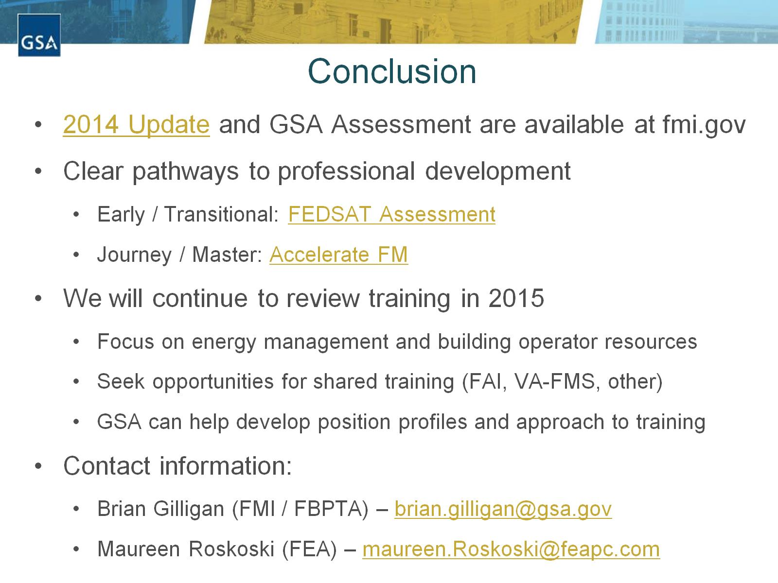
Conclusion

